Slide 1
Chapter 13
Fundamentals for Convex Optimization
--From convex sets to KKT optimality conditions
Prof. Lin ZHANG
School of Computer Science and Technology
Tongji University

Slide 3
Outline
Convex functions
Convex sets and affine sets
Convex functions
Optimization problems
Convex optimization problems
Duality

Slide 4
Convex sets and affine sets
Definition 1: Convex set
A set C is a convex set, if and only if , we have,
is also called the convex combination of x₁ and x₂
If a set is convex, the line segment linking any two points in that set also belongs to that set
convex not convex not convex

Slide 5
Convex sets and affine sets
Proposition 1:
IfC₁ and C₂ are two convex sets, their intersection is also a convex set
An example

Slide 6
Convex sets and affine sets
Definition 2: Affine set
A set C is an affine set, if and only if , we have,
is also called the affine combination of x₁ and x₂
If a set is affine, the line passing any two points in that set also belongs to that set

Slide 7
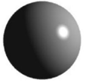
Convex sets and affine sets
Definition 3: Affine hull
The set of all the affine combinations of points in set C is called the affine hull of C, denoted by affC ,
where is any number
No matter whether C is affine or not, its affine hull affC is an affine set
affC is the smallest affine set that contains C; if C is an affine set, affC=C
Examples: what are the affine hulls for the following sets?

Slide 8
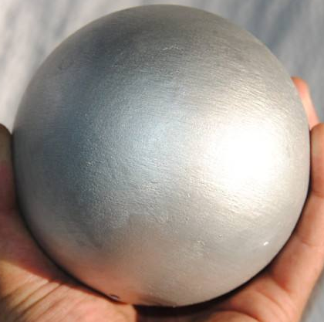

Convex sets and affine sets
For a set , we can define its interior and boundary (relative to )
The interior of C is defined as,
where , and can be any norm
The closure of C is defined as,
The boundary of C is defined as,
The set is an open set if and only if
In , what are the interiors and boundaries for a solid sphere and a thin paper?

Slide 9
Convex sets and affine sets
Definition 4: For a set , its relative (to its affine hull) interior is defined as,
where , and can be any norm
For a set , its relative (to its affine hull) boundary is defined as,
For a set , if , then and

Slide 10
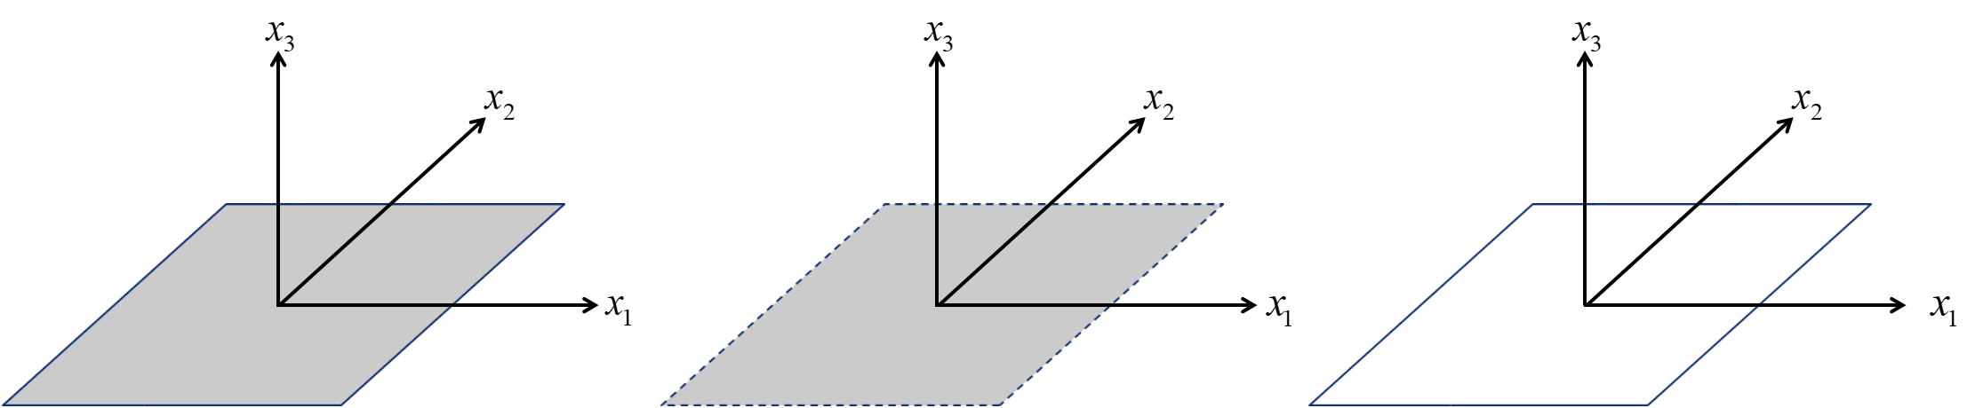
Convex sets and affine sets
Example: Consider a square in the plane in , defined as,
Its affine hull is the (x₁, x₂)-plane, i.e.,
The interior of C is empty, but its relative interior is,
The boundary of C is itself, but its relative boundary is the wire-frame outline,

Slide 11
Outline
Convex functions
Convex sets and affine sets
Convex functions
Optimization problems
Convex optimization problems
Duality

Slide 12
Convex functions
Definition 5: Affine function
If the function is the sum of a linear function and a constant, it is called an affine function, i.e., it has the form,

Slide 13
Convex functions
Definition 6: Convex function
A function is convex if its domain is a convex set, and if for all and any , we have,
(Eq. 1)
Definition 7: Strictly Convex function
In Def. 6, if Eq. 1 changes to,
and all the other conditions remain, then the function f(x) is called strictly convex
A typical convex function in 2D

Slide 14
Convex functions
Definition 8: Concave function
If -f(x) is a convex function, we say f(x) is a concave function
Definition 9: Strictly concave function
If -f(x) is a strictly convex function, we say f(x) is a strictly concave function

Slide 15
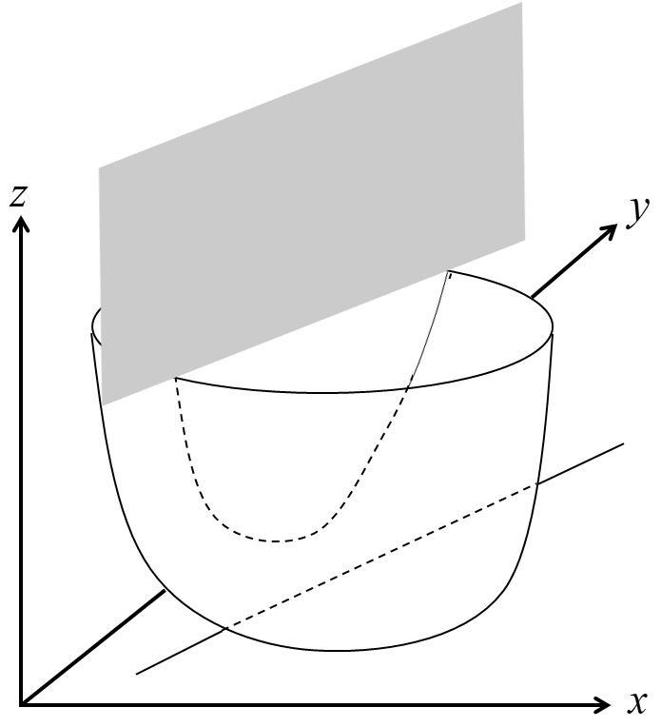
Convex functions
Proposition 2:
A function is convex if and only if it is convex when restricted to any line that intersects its domain. In other words, f is convex if and only if for all and all v, the function g(t)=f(x+tv) is convex on its domain

Slide 16

Convex functions
Proposition 3:
The affine function is a convex function and also is a concave function.
How to prove?

Slide 17
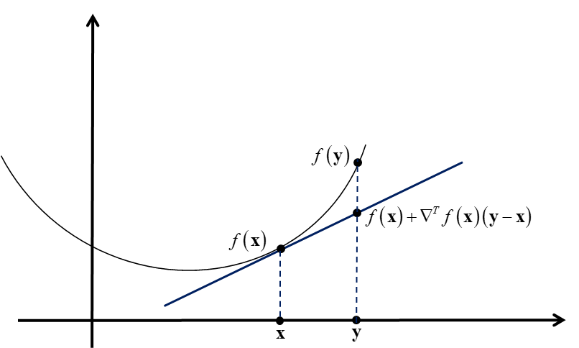

Convex functions
Proposition 4: First-order conditions to determine a convex function
Suppose f(x) is differentiable. Then, f(x) is convex if and only if domf is convex and
holds for all
For a formal proof, refer to the textbook

Slide 18
Convex functions
Proposition 5: First-order conditions to determine a strictly convex function
Suppose f(x) is differentiable. Then, f(x) is strictly convex if and only if domf is convex and
holds for all

Slide 19
Convex functions
Proposition 6:
Suppose that f(x) is a differentiable convex function. If x₀ is a stationary point of f(x), i.e., , x₀ is a global minimizer of f(x)
Proof:
f(x) is convex and differentiable, according to Prop. 4,
At x= x₀ ,
Since
x₀ is a global minimizer of f(x)

Slide 20
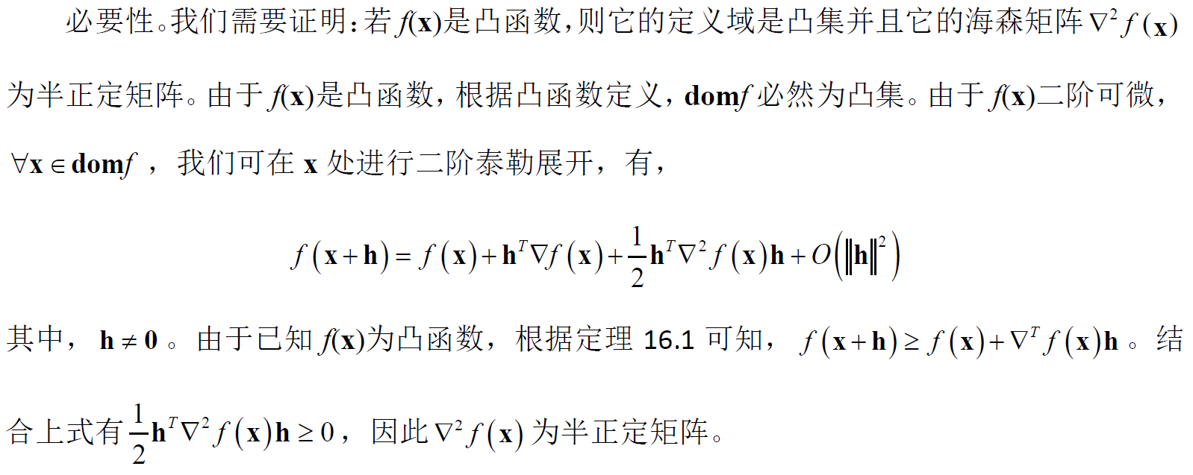
Convex functions
Proposition 7: Second-order conditions to determine a convex function
Suppose f(x) is twice differentiable. Then, f(x) is convex if and only if domf is convex and the Hessian matrix is positive semidefinite for all
prop. 4

Slide 21
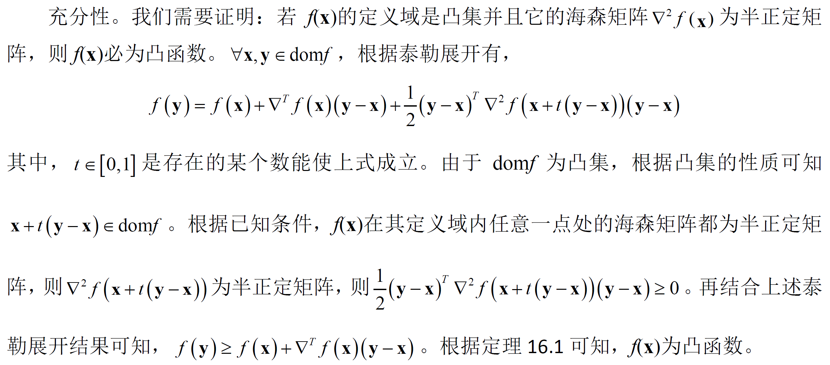
Convex functions
Proposition 7: Second-order conditions to determine a convex function
Suppose f(x) is twice differentiable. Then, f(x) is convex if and only if domf is convex and the Hessian matrix is positive semidefinite for all
prop. 4

Slide 22
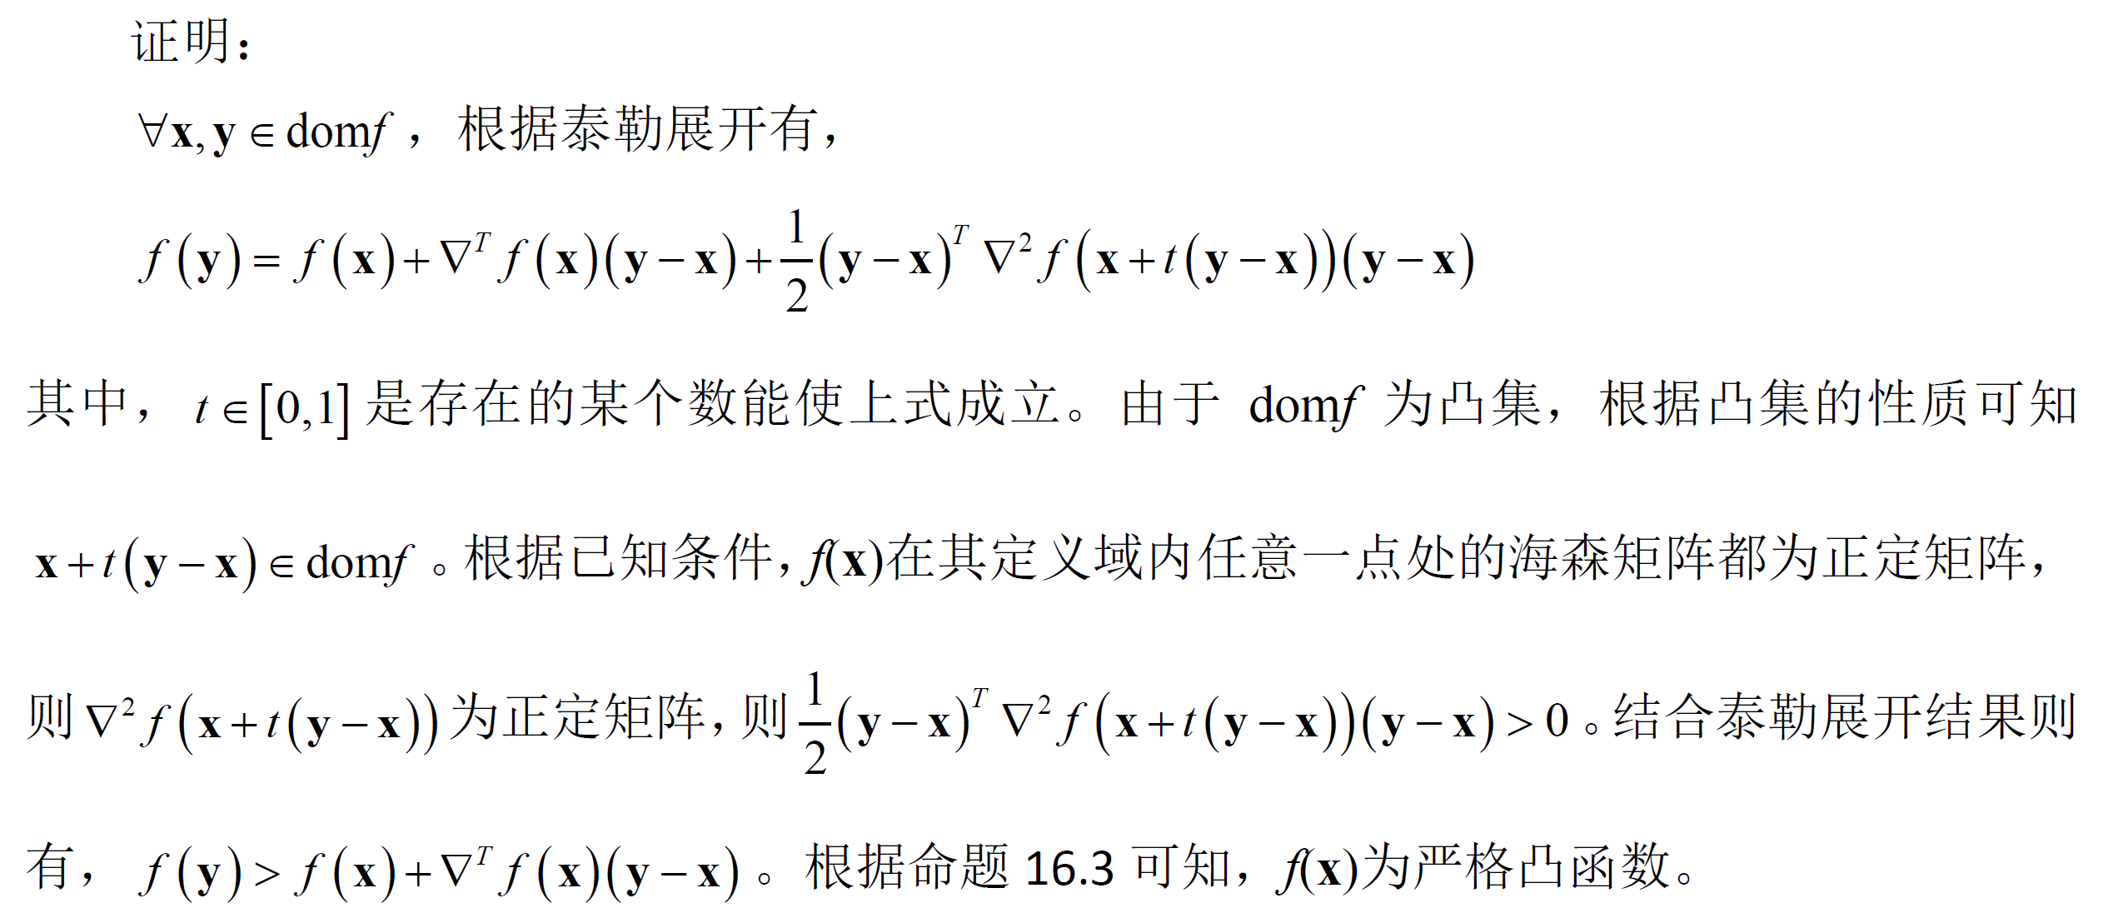
Convex functions
Proposition 8: Second-order conditions to determine a strictly convex function
Suppose f(x) is twice differentiable. If domf is convex and is positive definite for all , then f(x) is strictly convex
prop. 5

Slide 23
Convex functions
Proposition 8: Second-order conditions to determine a strictly convex function
Suppose f(x) is twice differentiable. If domf is convex and is positive definite for all , then f(x) is strictly convex
Please note that the above condition is only a sufficient condition for a function being strictly convex but not a necessary condition. In other words, for a strictly convex differentiable function, its Hessian matrix may not be positive definite.

Slide 24
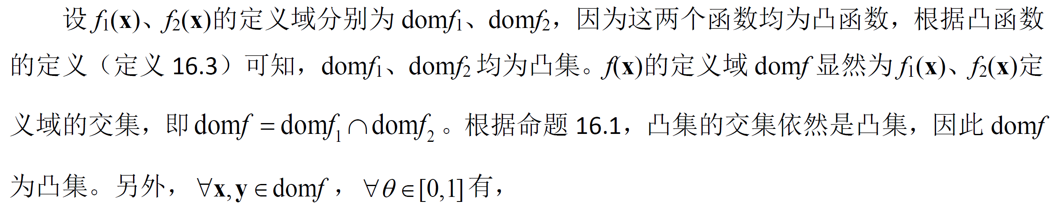
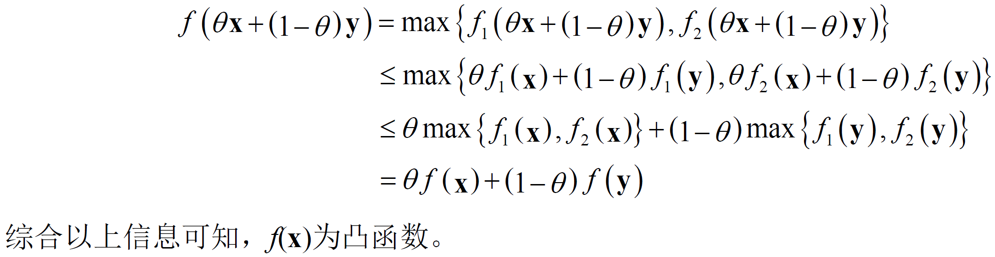
Convex functions
Proposition 9:
Suppose that f₁(x) and f₂(x) are convex. Then, their pointwise maximum f(x), defined by,
f(x) = max{f₁(x), f₂(x)}
with the domain , is also convex.
Def. 6
Prop. 1,

Slide 25
Convex functions
Proposition 10:
Suppose that f₁(x) and f₂(x) are concave. Then, their pointwise minimum f(x), defined by,
f(x) = min{f₁(x), f₂(x)}
with the domain , is also concave.
How to prove?

Slide 26
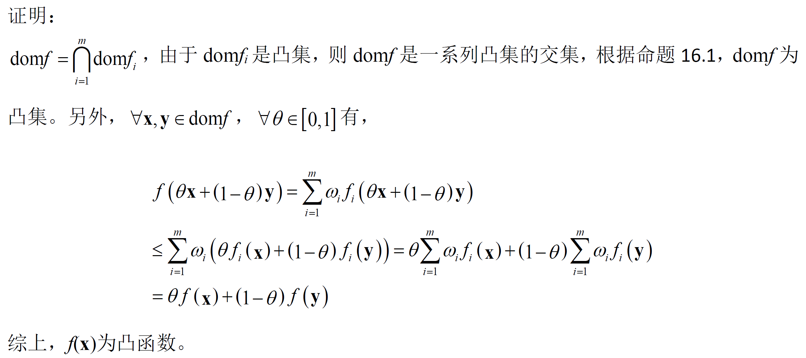
Convex functions
Proposition 11:
Suppose that f₁(x), f₂(x),…, f_{m}(x) are convex. Then, their nonnegative combination,
where , is also convex.
Prop. 1,

Slide 27
Convex functions
Proposition 12:
Suppose that f₁(x), f₂(x),…, f_{m}(x) are concave. Then, their nonnegative combination,
where , is also concave.
How to prove?

Slide 28
Convex functions
Definition 10: Quadratic function
A function of the following form,
where is a symmetric matrix and , is called a quadratic function
(Eq. 2)
It can be verified that the Hessian matrix of f(x) in Eq. 2 is
According to Prop. 7, if P is positive semidefinite, f(x) is convex
According to Prop. 8, if P is positive definite, f(x) is strictly convex

Slide 29
Outline
Convex functions
Convex sets and affine sets
Convex functions
Optimization problems
Convex optimization problems
Duality

Slide 30
Optimization problems
Definition 11: Optimization problem
A general optimization problem is expressed in the following form,
is the optimization variable, x* is the optimal solution;
is the objective function
are the inequality constraint functions
are the equality constraint functions
If m=p=0, we say the problem is unconstrained
The set of points for which the objective and all constraint functions are defined,
is called the domain of the optimization problem Def. 11.

Slide 31
Optimization problems
For a point , if it satisfies all the constraints and , we say x is a feasible point.
If there exists at least one feasible point, we say the problem Def. 11 is feasible, otherwise it is infeasible
The set of all feasible points is called the feasible set
If the optimal solution x* exists, it should be in the feasible set
The optimal value of the problem Def. 11 is defined as,
It can be easily known that,
if the optimal solution x* exists
if the problem Def. 11 is infeasible
if the problem Def. 11 is unbounded below

Slide 32
Optimization problems
It needs to be noted that even if the feasible set is not empty, the optimal solution of the problem Def. 11 may not exist
Example:
The feasible set of this problem is not empty, but the objective function is unbounded below and thus the optimal solution does not exist.

Slide 33
Outline
Convex functions
Convex sets and affine sets
Convex functions
Optimization problems
Convex optimization problems
Duality

Slide 34
Convex optimization problems
Definition 12: Convex optimization problem
We call the following optimization problem the convex optimization problem,
where f_{i}(x) (i=0,1,…,m) is convex
Please make a comparison between the definitions of the general optimization problem and the convex optimization prolem
Proposition 13:
The feasible set of a convex optimization problem is convex.

Slide 35
Convex optimization problems
As an example, the convex quadratic program is a typical convex optimization problem
Definition 13: Convex quadratic program problem
The convex quadratic program problem is expressed by,
where is positive semidefinite
Can you verify it is really a convex optimization problem?

Slide 36
Outline
Convex functions
Convex sets and affine sets
Convex functions
Optimization problems
Convex optimization problems
Duality

Slide 37
Duality
Definition 14: Lagrangian
We define the Lagrangian associated with the problem Def. 11 as,
where , are dual variables, and
Definition 15: Lagrange dual function
We define the Lagrange dual function of the problem Def. 11 as the minimum value of its Lagrangian over x,

Slide 38
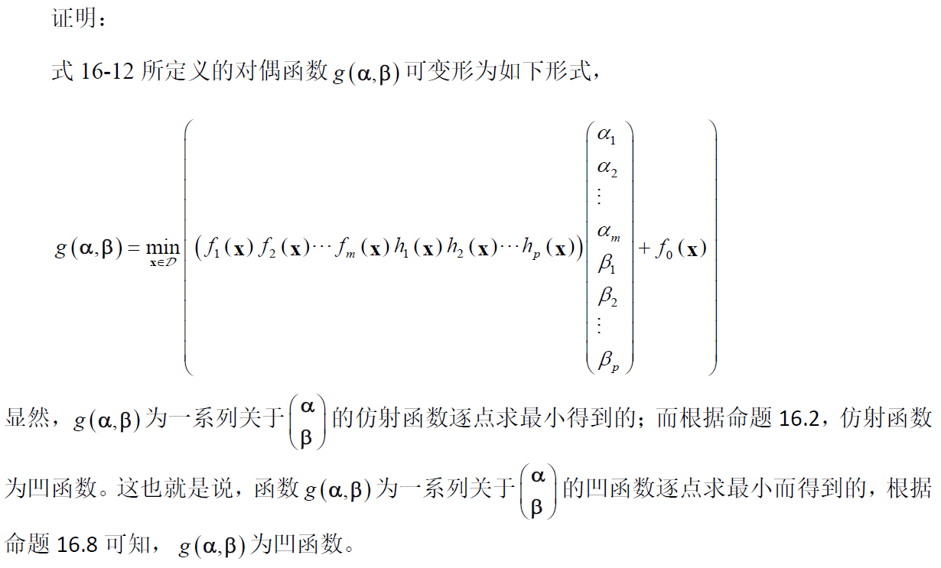
Duality
Proposition 14:
The Lagrange dual function is concave.
Def. 15
Prop. 3,
Prop. 10

Slide 39
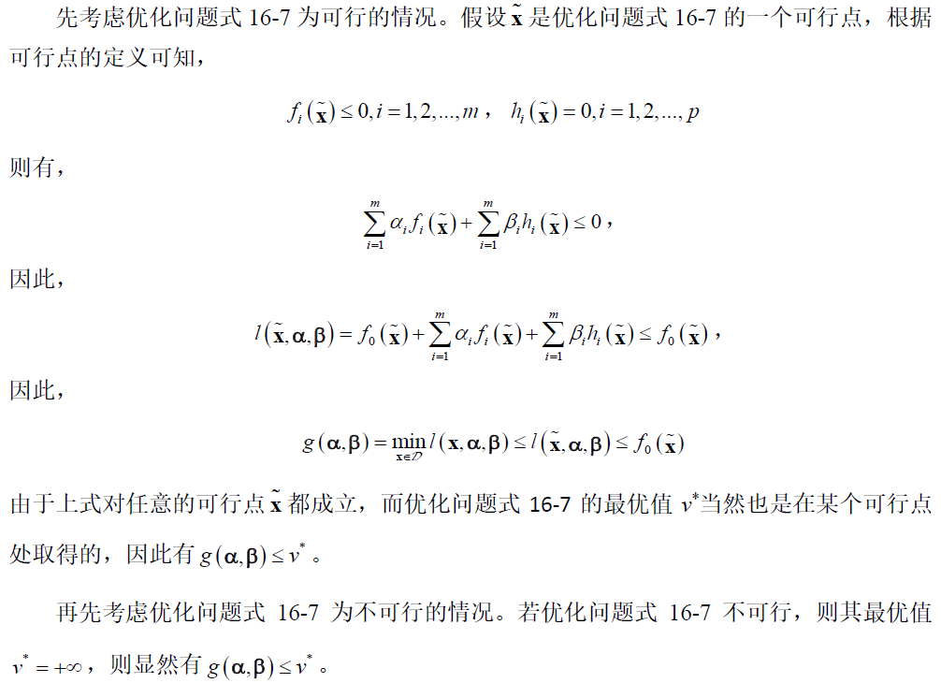
Duality
Proposition 15:
The Lagrange dual function yields lower bounds on the optimal value v* of the problem Def. 11, i.e.,
For any and any ,
Def. 11
Def. 11
Def. 11
Def. 11
Def. 11

Slide 40
Duality
Based on Prop. 15, we know that the Lagrange dual function yields the lower bounds for the optimal value of the problem Def. 11. Among these lower bounds, the largest one is the most valuable.
That motivates us to solve the following Lagrange dual problem
Definition 16: Lagrange dual problem
The above problem is called the Lagrange dual problem of the problem Def. 11, and accordingly, the problem Def. 11 is called the primal problem
We say a pair of dual variables is dual feasible if they satisfy and
It should be noted that no matter whether the primal problem Def. 11 is a convex optimization problem or not, its dual problem Def. 16 is a convex optimization problem!

Slide 41
Duality
Proposition 16: Weak duality
The general optimization problems (Def. 11) have the following weak duality property.
The optimal value of the dual problem is,
The optimal value of the primal problem (Def. 11) is,
Based on Prop. 15, it can be known that
Definition 17: Strong duality
For an optimization problem, if its optimal value is strictly equal to the optimal value of its dual problem, i.e.,
we say this optimization problem has the property of strong duality
What are the conditions an optimization problem needs to satisfy to have strong duality?

Slide 42
Duality
Proposition 17: Slater condition
Suppose that the primal problem is convex, i.e., of the form,
where f_{i}(x) (i=0,1,…,m) is convex. If there exists an such that,
(x is strictly feasible)
Then, such a primal problem has strong duality.
Proposition 18: Refined Slater condition
For a convex optimization problem, if the first k constraint functions f₁, f₂,…, f_{k} are affine, the strong duality holds provided the following weaker conditions: there is an with

Slide 43
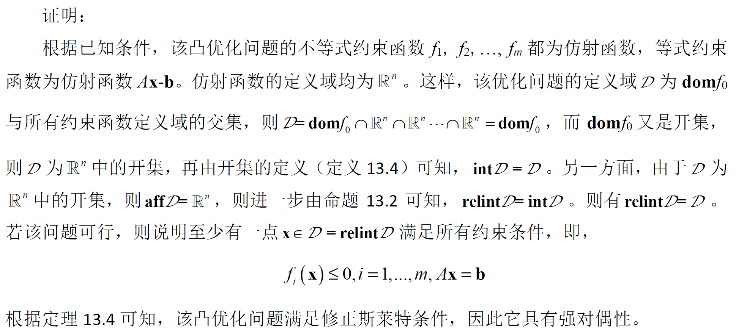
Duality
Proposition 19: Slater conditions for a convex problem whose constraint functions are all affine
If the primal problem is convex, all its constraints (both the equality constraints and the inequality constraints) are affine, and domf₀ is open, then the Slater condition reduces to feasibility. In other words, under such conditions, if the primal problem is feasible, it should satisfy the Slater condition and has strong duality.
Prop. 18

Slide 44
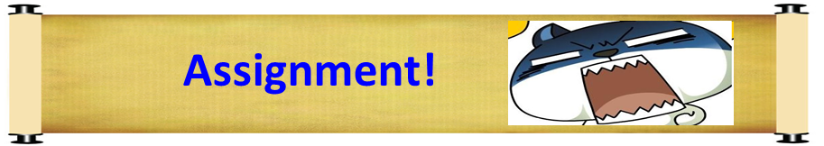
Duality
Definition 18: Duality gap
Suppose that x and are primal feasible and dual feasible, respectively. The duality gap associated with x and is defined as,
Proposition 20:
Suppose that x* and are primal feasible and dual feasible respectively. If the duality gap associated with them is 0, i.e.,
Then, x* and should be primal optimal and dual optimal, respectively, and the primal problem has strong duality

Slide 45
Duality
Suppose that an optimization problem (the primal problem) has strong duality. If x* is the optimal solution for the primal problem and is the optimal solution for the dual problem, then we have,
x* is the global minimizer of the Lagrangian
(Complementary slackness)

Slide 46
Duality
Proposition 21: KKT conditions for general optimization problems
Suppose that are differentiable and the primal problem has strong duality. If x* and are primal optimal and dual optimal respectively, they satisfy the following so-called KKT conditions,
(Eq. 3)
(Eq. 4)
(Eq. 5)
(Eq. 6)
(Eq. 7)

Slide 47
Duality
Proposition 22: KKT conditions for convex optimization problems
Suppose the primal problem is convex, i.e., f₀, f₁, f₂, …, f_{m} are convex and h₁, h₂, …, h_{p} are affine, all its constraint functions are differentiable, and the problem satisfies Slater conditions. Then, x₀ and are primal optimal and dual optimal, respectively, if and only if they satisfy KKT conditions,

Slide 48
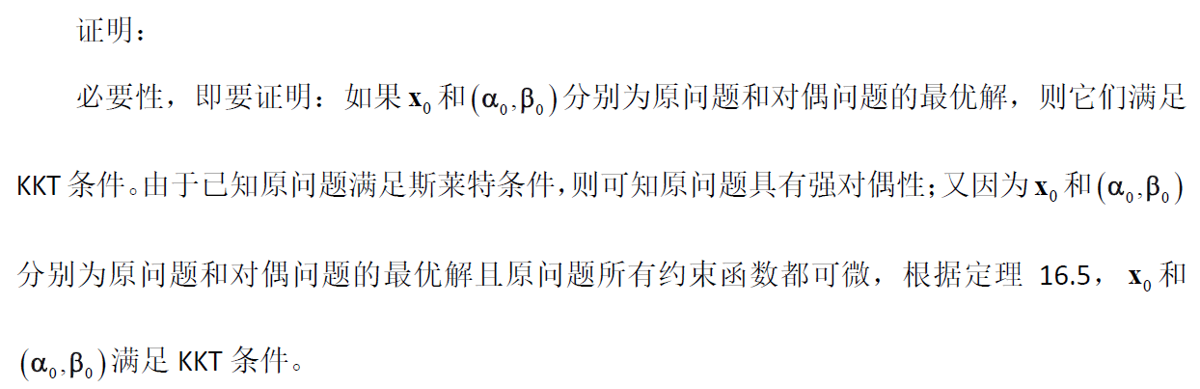
Duality
Proposition 22: KKT conditions for convex optimization problems
Prop. 21

Slide 49
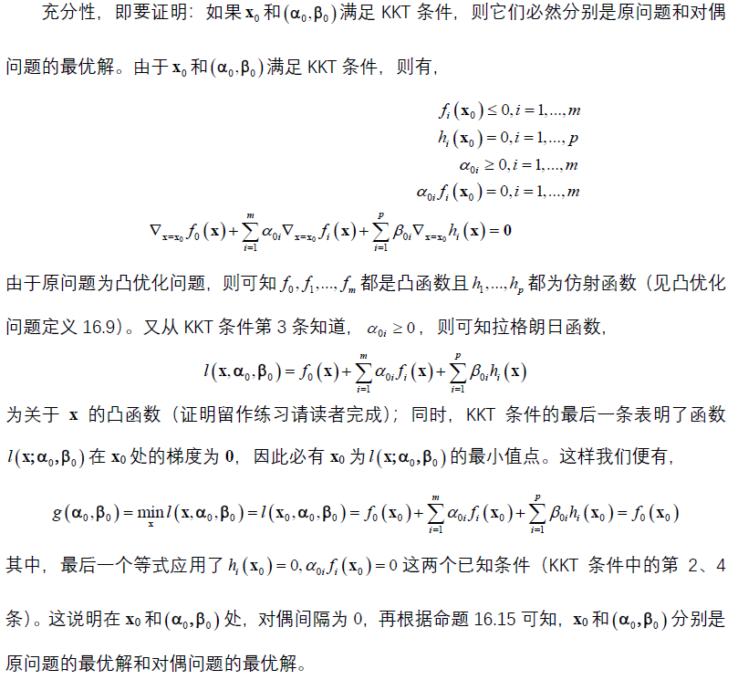
Duality
Proposition 22: KKT conditions for convex optimization problems
Def. 12
Prop. 20

Slide 50
Duality
Example: Consider the following equality constrained convex quadratic program problem,
where P is positive semidefinite
The Lagrangian is
Denote the optimal solution for the primal problem by x*, and the optimal solution for the dual problem by
For this specific problem, the last equation in KKT conditions is,
For this specific problem, the 2nd equation in KKT conditions is,
By solving the above linear equation system, we can get both the primal optimal and dual optimal solutions

Slide 51
Duality
(b) (c)
William Karush (March 1, 1917 to February 22, 1997), a mathematics professor at Northridge, California State University; In his master's thesis, he first proposed the necessary conditions for the optimal solution of inequality constrained problems
Harold W. Kuhn (July 29, 1925 to July 2, 2014), an American mathematician at Princeton University, won the 1980 von Neumann Theory Award together with David Gale and Albert William Tucker; He acted as a math consultant in the movie “Beautiful Mind”, which was adapted from Nash’s life in 2001
Albert William Tucker (November 28, 1905 to January 25, 1995), a Canadian mathematician, has made important contributions to topology, game theory and nonlinear programming; He had been a professor at Princeton University in 1933 and retired in 1974

Slide 52

Notes:
52

